Slide 1
Basic Kuali Training 101
August 19, 2021

Slide 2
FSU KUALI
Awarded RFP to Kuali 2020
FSU Team Formed to build workflow and forms to replicate our existing workflow structure.
Provost’s Office (Stephanie Sindy and Sara-Beth Bittinger)
Registrar’s Office (Jodi Ternent and Carol Cosner)
Faculty Senate (Ben Norris)
Graduate Services (Donna Yoder)
OIT (Lisa Cesnick, Joe Littley, Meghan Murphy)
Kuali Representatives (Shannon Resare and Terry)

Slide 3
Overview of the product
Curriculum Management (CM)
Catalog: https://frostburg-stg.kuali.co/catalog/student#/programs/rJNNd2lv_/rkUyqckPdd?bc=true&bcCurrent=Accounting%20(Major)&bcGroup=College%20of%20Business&bcItemType=programs

Slide 4
Basic Kuali 101 Agenda (Note: Not a technical training)
Getting Started:
FSU Training site:
https://www.frostburg.edu/information- technology/Training/kualitraining.php
Log into Kuali: https://frostburg-stg.kuali.co/
Using your FSU credentials.
Navigating Kuali Curriculum Management
Workflow
Courses
Programs
Audit Log/History
Reviewing Proposals/Action List
Agenda Builder
Fall Training Plan
Canvas Course: Curriculum Development

Slide 5
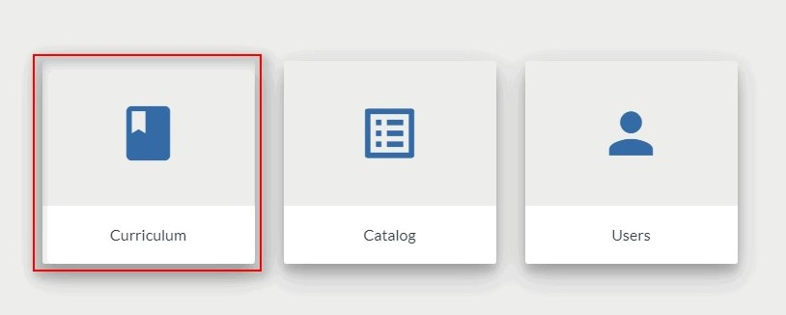
NAVIGATING KUALI CURRICULUM MANAGEMENT
Log into Kuali with your Frostburg Credentials.
Click on Curriculum.

Slide 6
Dashboard
My Proposals - where you can find any proposals you've created.
My Action List - where you can find any proposals that require an action from you.

Slide 7
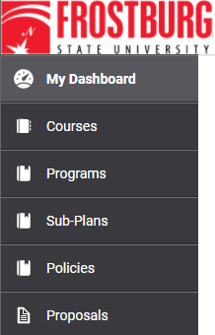
Left Navigation
Courses - Search courses and submit new/change proposals
Programs - Search programs and submit new/change proposals
Sub-Plans - Search sub-plans and submit new/change proposals
Policies - Search policies and submit new/change proposals
Proposals - Search for proposals in draft, review, approved or rejected
FSU Note: Past practice has allowed for a new program proposal to encompasses a package of changes. Kuali views each change as and individual proposal. If you submit all “proposals "at the same time, they will flow through the workflow together, so the proposal becomes a “package”.

Slide 8
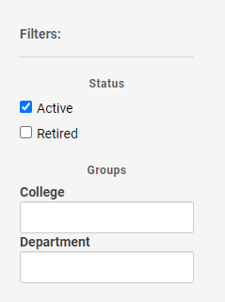
More Navigation
Use the search bar at the top of each page.
Use the Filters on the right side. Filter by Status, College, and/or Department.

Slide 9
Workflow
For the workflow for any proposals of courses/programs, please refer to the Canvas course Academic Curriculum Proposals Review and Governance Approval Process.
Steps within the curriculum development process will need to be acknowledged or approved within Kuali.
Course Workflow: https://frostburg-stg.kuali.co/cm/#/flowbot/5f75d4a53e35ee001be105e7
Program Workflow: https://frostburg-stg.kuali.co/cm/#/flowbot/5f74b8eb4eeaba001bb667f2
Subplan Workflow: https://frostburg-stg.kuali.co/cm/#/flowbot/60416bf3a340b8001b0e450b
There will be a separate training on the workflow.

Slide 10
COURSES
Creating A New Course
Select Course form the Left-Navigation and Click on “+ New Course”
Note: Special Workflow for IDIS Course Topic

Slide 11
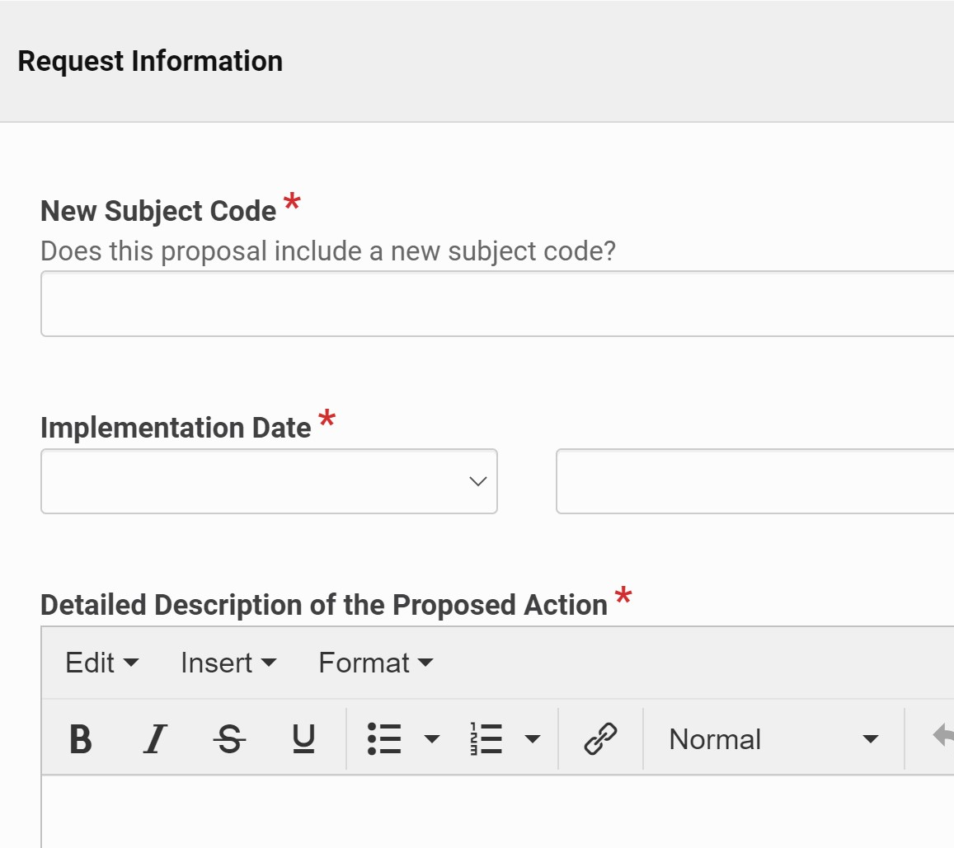
Request Information
New Subject Code - State Yes or No if a New Subject code is needed
Implementation Date - Date on which the course will be official
Detailed Description of the Proposed Action - Add additional information about the proposed course

Slide 12
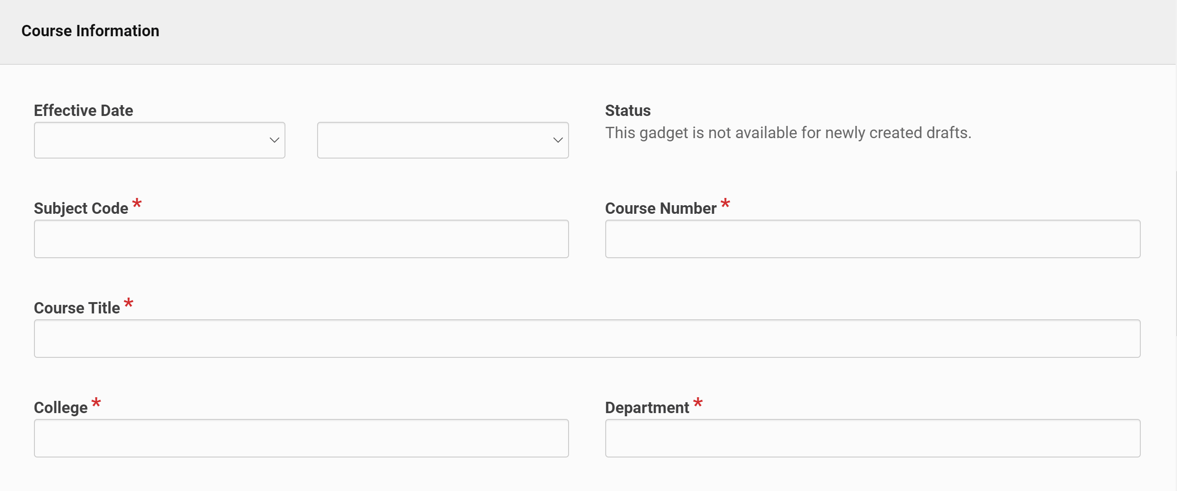
Course Information
Effective Date - Date on which the course will be first offered
Subject Code - Three- or four-letter code that relates to the department offering the course
Course Number - A number which a course is given based on the level of the course
Course Title - A short and general description of the subject matter covered
College - Select which college the course is associated with
Department - Select which department the course is associated with

Slide 13
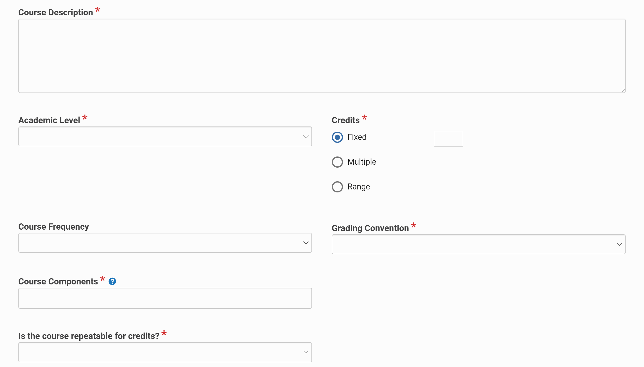
Course Information
Course Description - Brief description of the course in a few sentences
Academic Level - Select the level in which the course will be offered, such as Undergraduate or Graduate
Credits - Select between Fixed, Multiple, and Range
Course Frequency - Determine how often the course will be offered
Grading Convention - Select how the course will be graded
Course Components - The type of instruction given, i.e. LEC, LAB, SEM, etc.
Is the course repeatable for credits? - Select Yes or No to answer this question

Slide 14
Prerequisites
Add any courses or requirements the student must complete prior to registering for the new course.
Any information entered in this section can be seen by the student to inform them.
Examples of Prerequisites
Complete a Course
Earn a Minimum Grade in a Course
Corequisite
Special Permission
Math Level
Multiple Prerequisites

Slide 15
Prerequisites
Complete a Course
Earn a Minimum Grade In a Course

Slide 16
Prerequisites
Corequisite
Special Permission

Slide 17
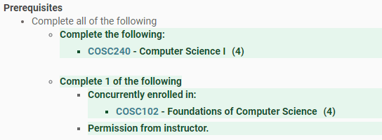
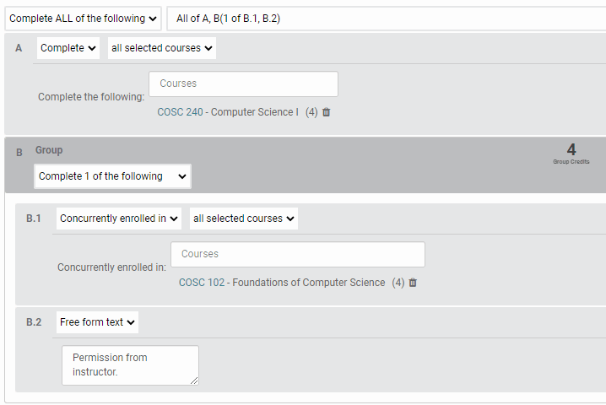
Prerequisites
Math Level
Multiple Prerequisites

Slide 18
Supporting Documentation
Upload any additional files that relate to the new course such as a syllabus or collegial correspondence.

Slide 19
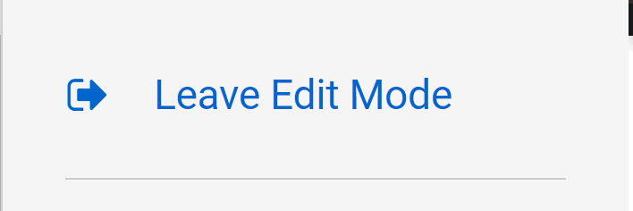
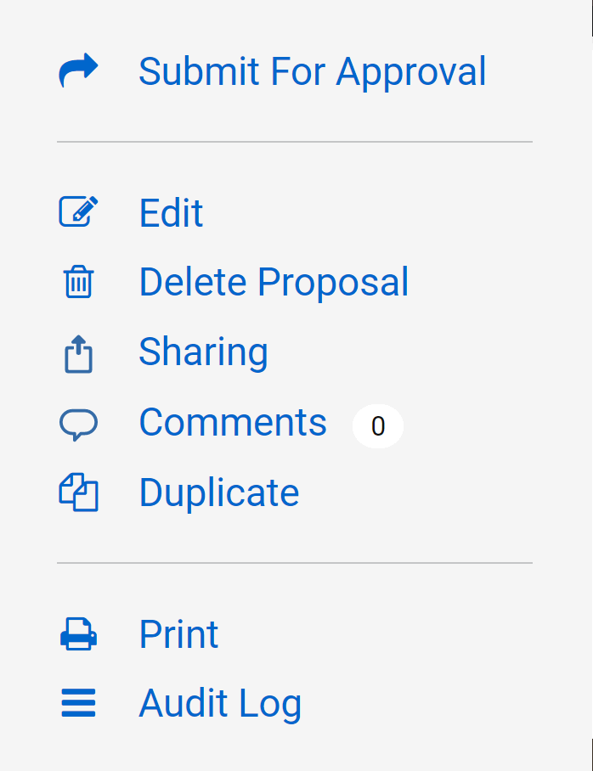
Submit Proposal
Once the proposal is complete, click "Leave Edit Mode"
Then click the "Submit for Approval" or other options
Submit for Approval - Starts the first step of the Workflow for Course Proposal.
Edit - Goes back to the proposal for additional changes
Delete Proposal - Deletes the draft of the proposal
Sharing - Allows you to send your proposal to others at the university for additional review
Print - Allows you to print the proposal
Audit Log - Summary of proposal changes

Slide 20
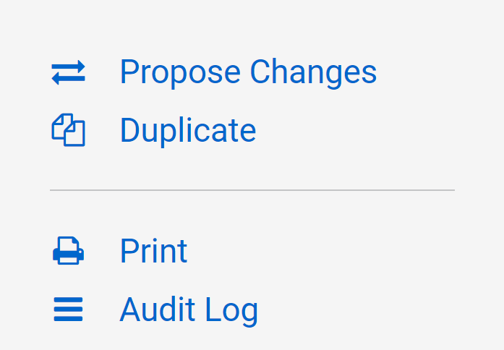
Proposing Changes to an Existing Course
Type the name of the course you would like to propose changes to in the search bar. Click on the proposal in search results.
Click on Propose Changes.
Select the Change Type

Slide 21
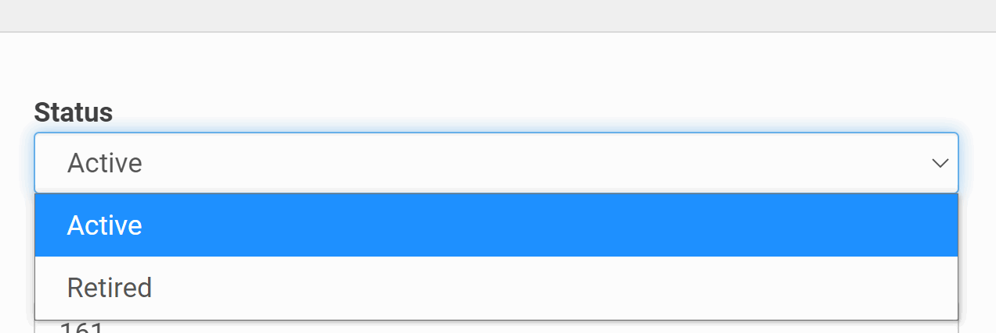
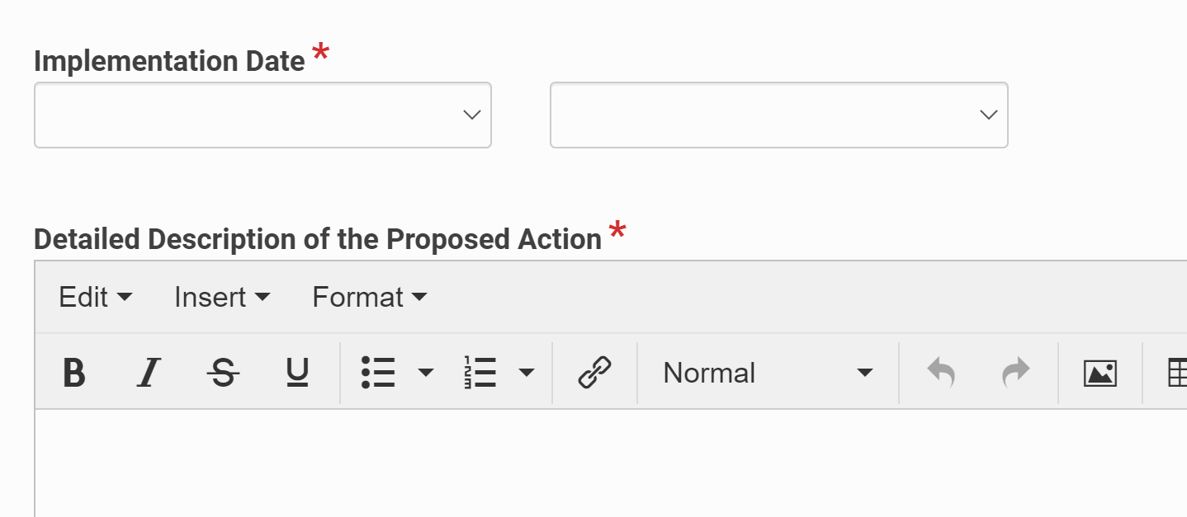
Proposing Changes to an Existing Course
Status
There are two options to make a course which are Active and Retired.
Retired will remove the course from the catalog and it cannot be scheduled.
Identify the semester in which you wish for the change to take effect. (Not the semester you are proposing the change)
Give a detailed description of the change in the proposal being created. In this section, specify all of the changes that you are making and the rationale for why these changes need to occur.

Slide 22
Programs
New Programs/Name Changes
Must go through additional approval for input into Kuali.
Changes to Existing Program

Slide 23
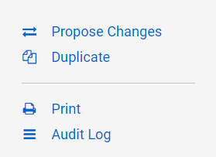
Changes to Existing Program
Select the Programs tab on the left navigation and search for the program that needs edited and click on it.
On the right side, click Propose Changes.
Select Change Type

Slide 24
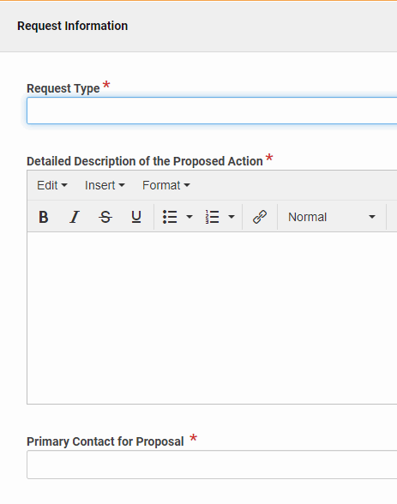
Request Information
Request Type - Select the type of request from the drop-down
Detailed Description of the Proposed Action - specify all of the changes that you are making and the rationale for why these changes need to occur
Primary Contact for Proposal - name the person who should be contacted for proposal questions

Slide 25
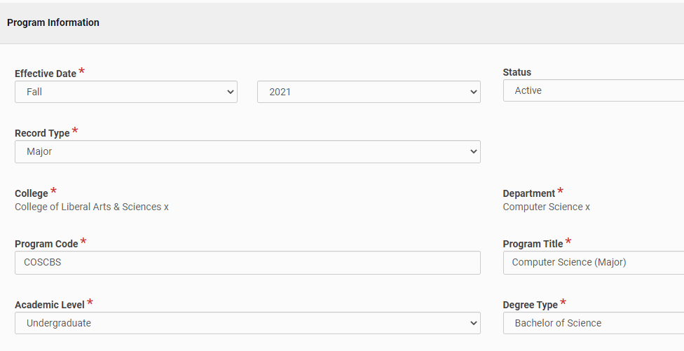
Program Information
Effective Date - Date on which the program will be first offered
Status - Active or Retired (Retired will remove the program from the catalog.)
Record Type - The category of the program, e.g. Major, Minor, etc.
College - Where the Department/Program is housed
Department - Where the program is housed
Program Code - Program abbreviation
Program Title - Name of the Program, including category in parenthesis
Academic Level - Undergraduate, Graduate, or Post-Graduate
Degree Type - Degree earned from Program

Slide 26
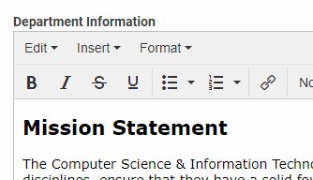
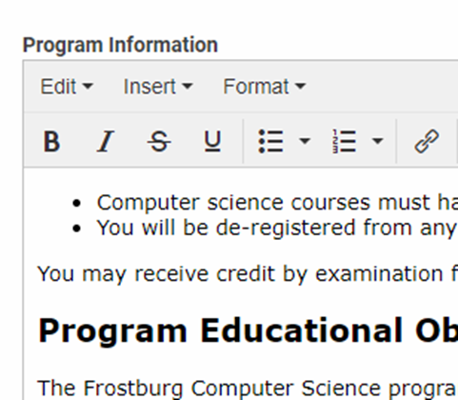
Department & Program Information
Department Information
Include information about the department such as mission statement, contact, and related programs.
Program Information
Include information about the program such as objectives, outcomes, and credit specifications.

Slide 27
Program Requirements
The requirements section is filled with the courses a student must complete to be awarded a degree. Changes to this section will be for a future catalog year.
Examples of Program Requirements
Complete All
Complete All with Multiple Rules
Complete Minimum Number of Courses
Earn Minimum Number of Credits with Courses Listed
Earn Minimum Number of Credits with Free Form Text
Free Form Text

Slide 28
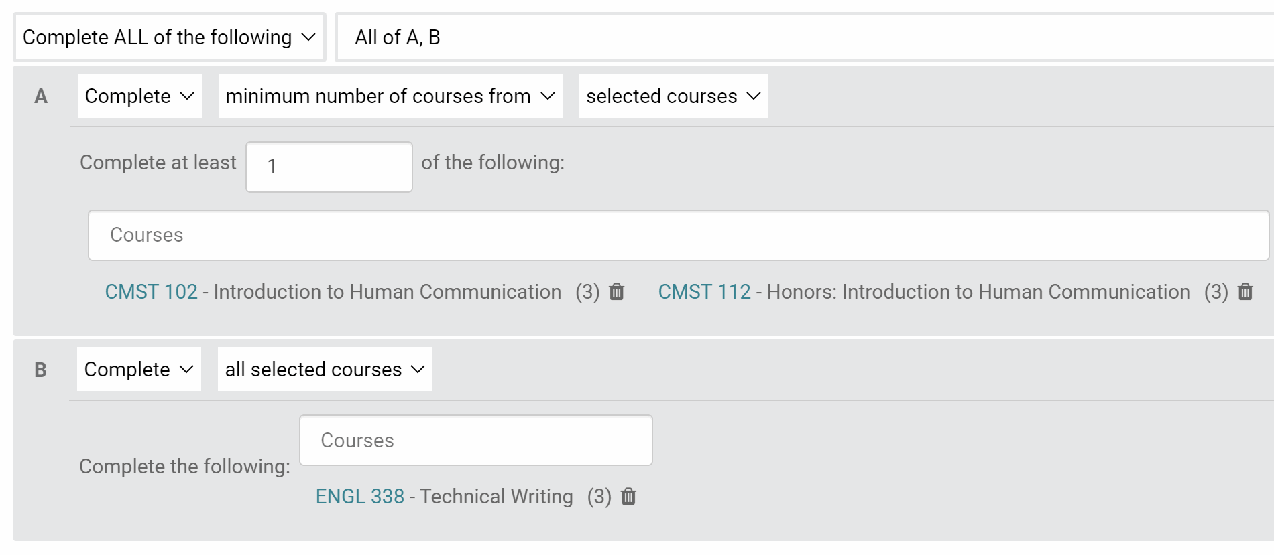
Program Requirements
Complete ALL
Complete All with Multiple Rules

Slide 29
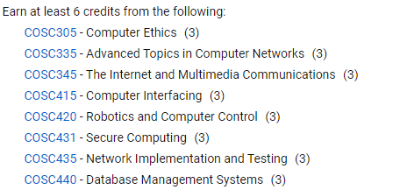
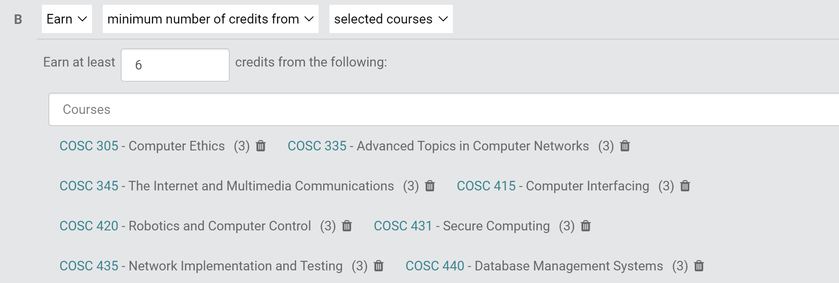
Program Requirements
Complete Minimum Number of Courses
Earn Minimum Number of Credits with Courses Listed

Slide 30
Program Requirements
Earn Minimum Number of Credits with Free Form Text
Free Form Text

Slide 31
Audit Log
The Audit Log shows the history of a proposal or course in Kuali.
Type the course or program into the search bar.
Click on the course or program you want to view from the search results.
Click on the Audit Log on the right-side of the proposal.
This will show the Audit Log. To view the details of the exact change that was made by the listed user, click on "View/Hide".

Slide 32
History
The history is the record of proposals that have been submitted.
Go to the upper-right corner and click the semester.
It will bring you to previous versions of the course. Click on View Original Proposal.
The proposal that was submitted for that change will appear. The Audit Log is combined after a change is approved. Click View Active Course to view the Audit Log.

Slide 33
Reviewing Proposals
The workflow lists the designed people who will need to review proposals.
Multiple Ways to Review:
Email from Kuali with Review Prompt
Link to Proposal Sent from Other Users
Action List
Proposal Section on the Left Navigation
Agenda Builder

Slide 34
Reviewing Proposals
Three Review Options
Approve (Or Re-Approve)
If you approve the proposal, select Approve (or Re-Approve).
Send Back
If the proposals needs changes, select Send Back. Add comments to explain why you are sending the proposal back. Select whether the proposal will come back to you or through the workflow. Use the “Prev/Next” to determine the person who will make the changes.
Reject
Rejecting a proposal does not allow for any revisions. A new proposal will need to be created from scratch after rejection.

Slide 35
Action List
The Action List is a list of items that are waiting for your approval.
It can be found in the upper-right corner.

Slide 36
Training plan and implementation
Today is the Basic Training, we will post the slides on the training page.
August 30th: Workflow Training
Multiple sessions in September for anyone initiating any curriculum development process. Please contact ssindy@frostburg.edu to set up a session.

Slide 37
Path Forward
Anything already in paper workflow-approved in the spring 21 by a college curriculum or governance committee- will continue with paper and the previous practice. Anything approved on paper, stays on paper.
Anything NEW-All NEW curriculum proposals beginning with a proposer will start in KUALI.

