Slide 1
New Program Proposals
September 2021

Slide 2
New Program Proposal Agenda
Programs Kuali Basics
“Proposal Groups”
Curriculum Proposal Process and Timeline
Which proposals need to go to MHEC?
Which proposals go to PAG and when does that happen?
New Degree Program (New Major)
New Areas of Concentration
Change in Program Requirements

Slide 3
Programs Kuali Basics 1. Log into Kuali with your Frostburg Credentials. FSU Training site: https://www.frostburg.edu/informationtechnology/Training/kualitraining.php Log into Kuali PRODUCTION: COMING SOON! Using your FSU credentials. 2. Click on Curriculum.

Slide 4
WARNING
WE ARE IN PRODUCTION.
Any curriculum proposal will generate workflow.

Slide 5
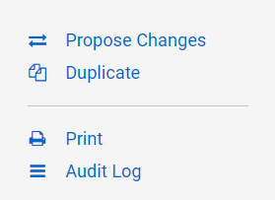
Changes to Existing Program
Select the Programs tab on the left navigation and search for the program that needs edited and click on it.
On the right side, click Propose Changes.
Select Change Type

Slide 6
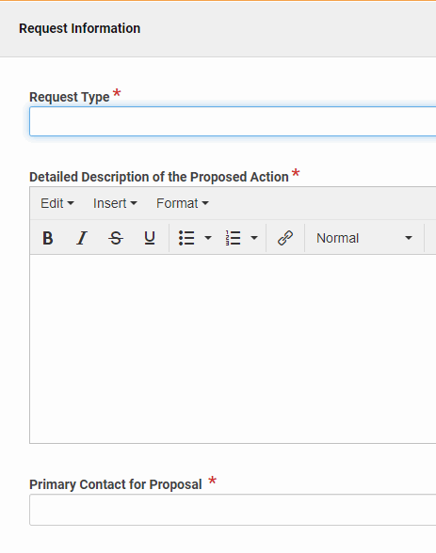
Request Information
Request Type - Select the type of request from the drop-down
Detailed Description of the Proposed Action - specify all of the changes that you are making and the rationale for why these changes need to occur
Primary Contact for Proposal - name the person who should be contacted for proposal questions

Slide 7
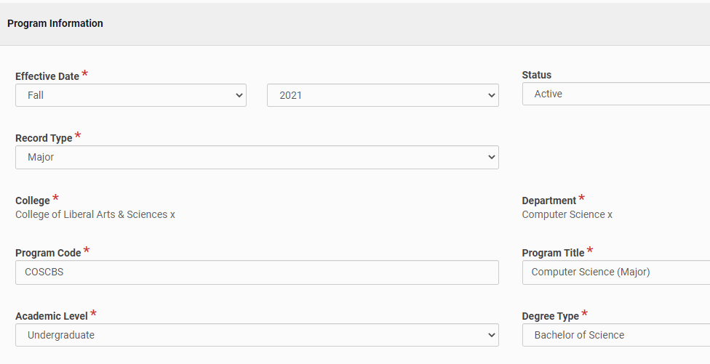
Program Information
Effective Date - Date on which the program will be first offered
Status - Active or Retired (Retired will remove the program from the catalog.)
Record Type - The category of the program, e.g. Major, Minor, etc.
College - Where the Department/Program is housed
Department - Where the program is housed
Program Code - Program abbreviation
Program Title - Name of the Program, including category in parenthesis
Academic Level - Undergraduate, Graduate, or Post-Graduate
Degree Type - Degree earned from Program

Slide 8
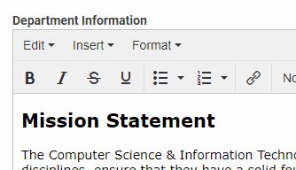
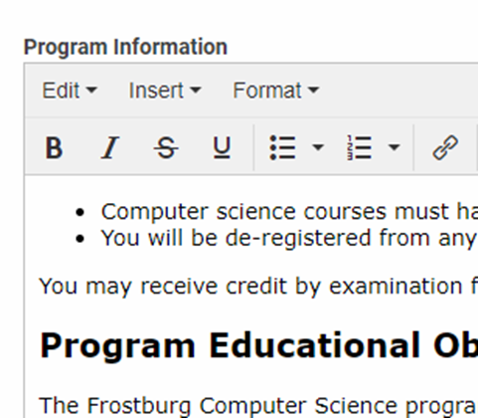
Department & Program Information
Department Information (if applicable)
Include information about the department such as mission statement, contact, and related programs.
Program Information (if applicable)
Include information about the program such as objectives, outcomes, and credit specifications.

Slide 9
Program Requirements
The requirements section is filled with the courses a student must complete to be awarded a degree. Changes to this section will be for a future catalog year.
Examples of Program Requirements
Complete All
Complete All with Multiple Rules
Complete Minimum Number of Courses
Earn Minimum Number of Credits with Courses Listed
Earn Minimum Number of Credits with Free Form Text
Free Form Text

Slide 10
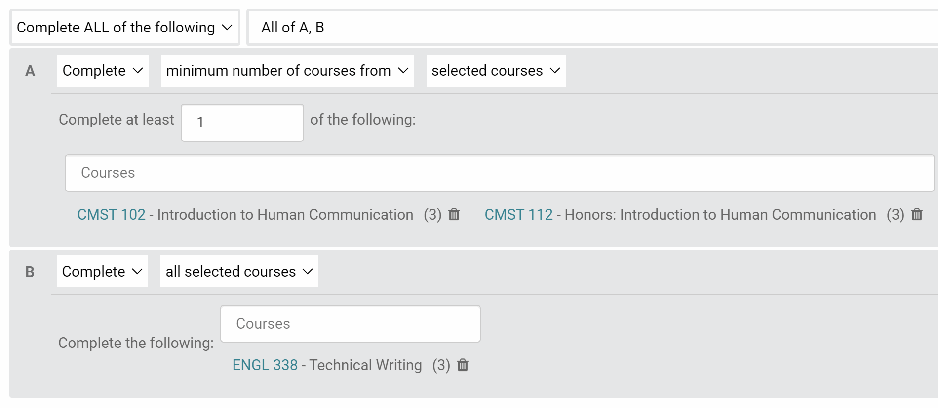
Program Requirements
Complete ALL
Complete All with Multiple Rules

Slide 11
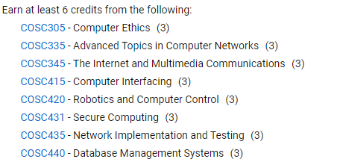
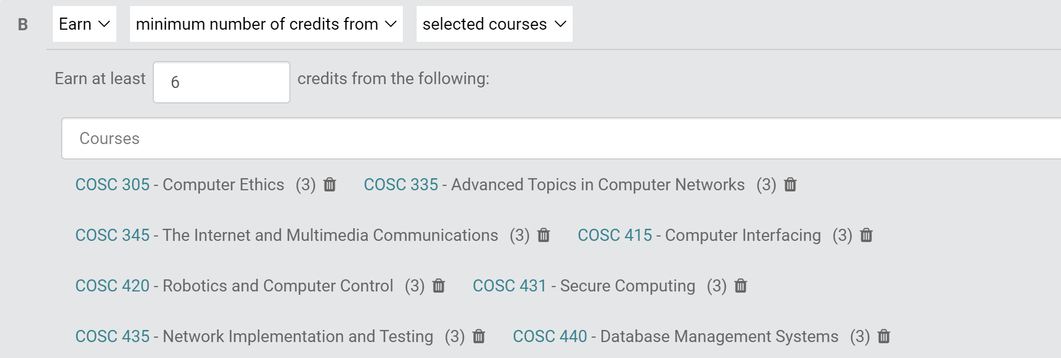
Program Requirements
Complete Minimum Number of Courses
Earn Minimum Number of Credits with Courses Listed

Slide 12
Program Requirements
Earn Minimum Number of Credits with Free Form Text
Free Form Text

Slide 13
Proposal Groups-ability to group multiple proposals within the workflow Proposal Types

Slide 14
Using Proposal Groups
If a new Program has New courses:
Tip: Create the new courses first and then add them to the new program.
To bundle multiple proposals (previously how we packaged or bundled multiple proposals to be considered as one agenda item), utilize “Proposal Groups”:
What are Proposal Groups? Proposal Groups are used to support users who want to group and follow the approvals of multiple, related items. For example: Proposal Groups can bundle together all proposals related to a new program including new courses or new minors.
How do I access Proposal Groups? Click Proposal Groups in the left navigation panel

Slide 15
Creating a proposal Group
Click Proposal Groups in the navigation panel.
Click the New Proposal Group button in the main proposal group view.
Fill out fields on proposal groups form. Note: All changes made in edit mode are automatically saved.
To exit edit mode, click Leave Edit Mode.
How do I view, sort, and search all existing proposal groups?
Click Proposal Groups in the left navigation panel.
Click the titles of each column (e.g., Name, Courses) to sort.
Click anywhere in a row to navigate to the proposal groups detail view.
How do I view the completion status of a proposal groups?
From the main proposal groups view, view the completion percentage in the right column titled Progress OR
Click into a specific proposal group to see the completion progress.
Please note: Proposal groups track items to approval completion, and items that are in draft, inactive, or retired will affect the completion percentage of a proposal group.
How do I edit a proposal group?
From the proposal group detail view, click Edit in the right panel to enter edit mode.
To exit edit mode, click Leave Edit Mode.

Slide 16
Curriculum Proposal Process and Timeline
The curriculum proposal process occurs in three phases: Proposal Preparation, Shared Governance Review, and Final Approvals.
The information describes the steps to be taken in each phase, including the order of those steps and an approximate timeline. Please plan accordingly based on these timelines and the catalog deadline published by the Provost's office to ensure timely submission and review of your curriculum proposal.
All steps in each phase must be complete before moving to the next phase. FSU will use Kuali Curriculum Management software to manage this workflow beginning in the fall of 2021.
The information replaces the former curriculum proposal flowcharts.

Slide 17
Phase 1: Proposal Preparation
In Phase 1, the curriculum proposal is written, the supporting documentation is collected, and the preliminary approvals and consultations are done. The proposal should be in its final form before leaving Phase 1. Substantive changes made to a proposal during Phases 2 or 3 can result in the proposal being returned to Phase 1. Phase 1 takes as long as the department or program needs to prepare the proposal.
All NEW program programs must submit a letter of intent (Links to an external site.) to develop the program and submission to USM for distribution for comment or questions.

Slide 18
Phase 1: Proposal Preparation
Approvals needed in Phase 1:
Department Curriculum Committee and/or Program Steering Committee
Department Chair and/or Program Coordinator
Dean of the College
Registrar's Office (for course)
Program Advisory Group (program proposals only)
Consultations that should occur in Phase 1:
Provost's and Dean's Offices (all program proposals)
Registrar's Office (for programs)
Other affected departments
Library (new programs)
Budget Office (new programs)

Slide 19
Phase 2: Shared Governance Review (3 months)
In phase 2, the proposal is reviewed by shared governance bodies at the college- and university-level.
The only changes a proposal should undergo in phase 2 are amendments based on shared governance review. Substantive changes require the proposal to return to phase 1. Phase 2 is divided into three stages, and all reviews in each stage can be completed concurrently.
The next stage cannot begin until all reviews in the previous stage are complete.

Slide 20
Phase 2: Shared Governance Review (3 months)
Stage 2a (month 1):
College Curriculum Committee
Honors Program Advisory Group (Honors Courses Only)
University Undergraduate Curriculum Requirements (GEP, IDIS, Tech Fluency, Capstone)
Stage 2b (month 2):
Academic Affairs Committee (Undergraduate courses and programs)
Graduate Council (Graduate courses and programs)
Institutional Priorities and Resources (most proposals requiring MHEC approval)
Stage 2c (month 3): Faculty Senate

Slide 21
Phase 3: Final Approvals (up to 3 months)
Phase 3 covers the final on- and off-campus approvals needed before curricular changes can be published in the catalog.
No changes are possible to the proposal at phase 3. Any changes in phase 3 require the proposal to return to phase 1 or phase 2.
MHEC approvals can take 60-90 days, and USM has specific submission windows in order for a proposal to be on the agenda of the Education Policy and Student Life Subcommittee.
On-Campus Approvals (all proposals)
Provost
President

Slide 22
Phase 3: Final Approvals (up to 3 months)
Off-Campus Approvals:
MHEC (60-90 days):
New programs (degrees, majors, and standalone certificates)
Substantial Modifications (new concentrations, offering program at off-campus site, change of 33% or more of credit hours)
Non-substantial modifications (articulation agreements, suspend or discontinue program, new certificate in existing program, change in modality, new title or CIP code, changes of less than 33% of credit hours)
USM (60-90 days):
Creation and suspension of academic programs requires approval of the Education Policy and Student Life Committee (meets every other month) and then the full Board of Regents the following month.

Slide 23
Which proposals need to go to MHEC?
Types of Proposals:
New Academic Programs, Degrees and Stand-Alone Certificate Programs
Substantial Modification to Existing Program
Certificate Programs
Cooperative Programs
Distance Education Programs
Non-Substantial Program Modifications

Slide 24
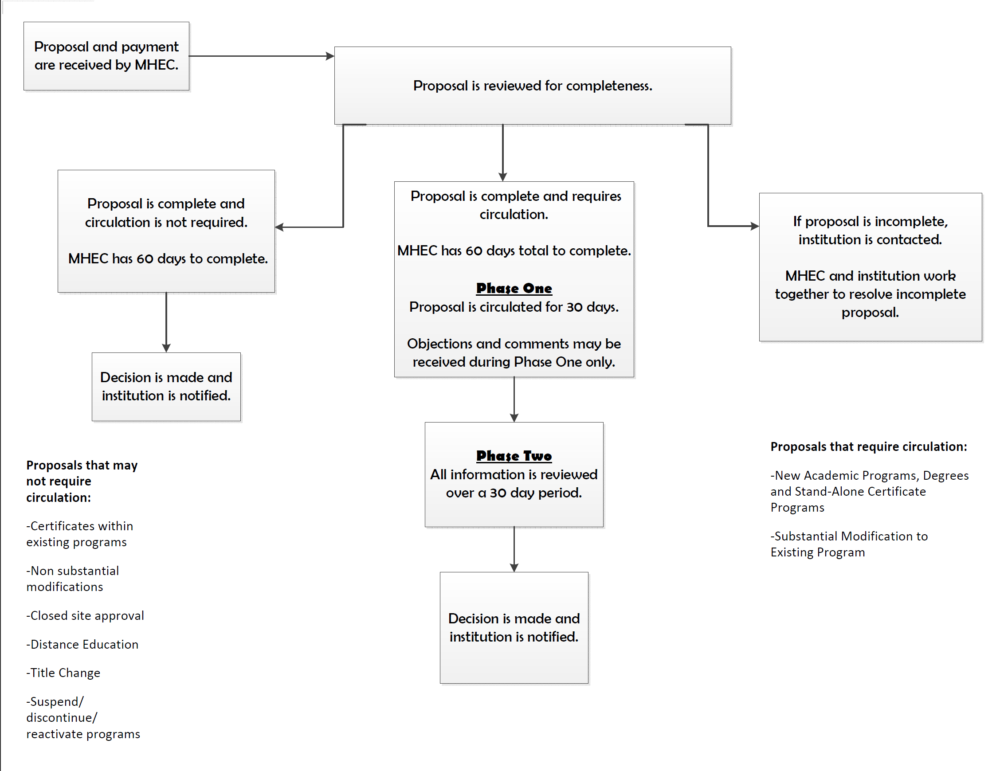
MHEC
Process
Flow

Slide 25
New Academic Programs, Degrees and Stand-Alone Certificate Programs
An institution shall submit a program proposal for a new program to:
establish instruction leading to a formal award in a subject area in which the award is not presently authorized,
establish an instructional program in a subject area which will offer a degree at a different degree level than presently authorized,
establish a new major by combining course work from two or more existing degree programs, or
establish a degree that is of a different type than that presently authorized.
Reactivate Program: After a 3-year period, the institution shall notify the Secretary in writing of their intent to either discontinue or reactivate a suspended program accompanied with the appropriate cover sheet. A program proposal is required to reactivate a discontinued program.

Slide 26
Substantial Modification to Existing Program
An institution shall submit a program proposal for a substantial modification to:
change more than 33 percent of the major course work in an existing program;
establish a new area of concentration within an existing program, and/or;
establish a new program title within an approved program.
offer an existing program as an off-campus program

Slide 27
Certificate Programs
Directed Technology Certificate is a specialized learning program designed for community colleges intended to meet specific employer training needs. It requires the completion of at least 12 credits but no more than 24 credits.
New Certificate Programs within an existing degree area. These programs are distinctly different from directed technology certificates and fall into several categories: Lower-Division Certificates, Upper-Division Certificates, Post-Baccalaureate Certificates, Certificates of Advanced Study, and Professional Certificates.
New Stand Alone Certificate: Please refer to COMAR 13B.02.03.25 for information on the differences between the certificates and the guidelines for proposing a certificate program.

Slide 28
Cooperative Programs & Combined Programs
The proposed program shall be planned by representatives from each cooperating institution. Identical proposals for each institution shall go through the normal program approval procedures for the institutions and segments, including formal approval and recognition by each governing board. A memorandum of understanding between or among cooperating institutions shall be included when the program proposal is submitted along with a cover sheet.
Combined Program with two institutions and two degrees:
Utilize existing approved programs: Submit MOU with non-substantial modification. For this type of agreement where the programs have been approved and exist independently at each institution, no fee for a cooperative program is needed. Submit a cover letter to the Secretary, the signed MOU, and the non-substantial modification cover sheet (Links to an external site.). On the cover sheet, select articulation agreement.
Combined Program where there are two degrees and one institution:
Separate program proposals per degree: Substantial Modification
Limit to 9 shared credit between degree level
Example (see page 10): https://mhec.maryland.gov/institutions_training/documents/acadaff/acadproginstitapprovals/Proposals/PP18459.pdf (Links to an external site.)
Utilization of Intersession and Summer

Slide 29
Distance Education Programs
A program proposal that uses distance education as a modality must have institutional approval to offer distance education. Additionally, the program proposal must identify distance education as a program modality and address the C-RAC guidelines. For more information click on the hyperlink. A non-substantial modification cover sheet must be submitted with the proposal submission.

Slide 30
Non-Substantial Program Modifications
For changes that do not meet the requirements for substantial modifications, the institution may submit the appropriate cover sheet accompanied with a letter of notification that describes and provides a justification for the proposed change, along with supporting and/or comparative documentation (i.e. course outlines, course descriptions) from the existing and proposed programs.
MHEC requires a non-substantial modification for all new courses and course deletions from an approved academic program.
Title Change of an Approved Program
An institution may submit a brief letter of request accompanied with the appropriate cover sheet indicating the existing and proposed titles and a justification for the proposed title change.
Discontinue Program
An institution shall provide written notice to the Commission in advance of a program's discontinuance accompanied with the appropriate cover sheet.
Suspend Program
Before suspending a program, the institution shall notify the Secretary in writing accompanied with the appropriate cover sheet.

Slide 31
Which proposals go to PAG and when does that happen?

Slide 32
Which proposals go to PAG and when does that happen?
PAG reviews and recommends compliance and operational policies and practices for both undergraduate and graduate proposals that address the following:
addition or deletions of degree programs and/or program locations;
substantial change for degree majors and programs;
changes in instructional delivery methods;
creation/revision of Memorandums of Understanding (MOU) with other institutions of higher education both in the US and abroad (include articulation agreements).
The committee will serve as guide for proposal development on issues of implementation which may impact accreditation, financial aid, admissions, degree attainment, tuition/fees, audit compliance, and any additional information required to secure internal and external approval. The PRC does not address any curriculum issues.

Slide 33
New Degree Program (New Major)

Slide 34
New Degree Program (New Major)
A new degree program proposal is perhaps that most complex curriculum proposal requiring the most steps and supporting documentation.
A new degree program is defined by MHEC as one of the following:
An instructional program leading to a formal award in subject area in which award is not presently authorized (e.g. offering a BS in African American Studies).
An instructional program in subject area in which formal award is offered at a different degree (e.g. offering a MS in Geography).
A new major created by combining course work offered in two or more existing degree (e.g. creating a BS in Data Science using course work in Computer Science and Mathematics).
An award of a different type in a subject matter in which another formal award at the same level is already offered (e.g., MS in Management & MBA).

Slide 35
New Degree Program (New Major)
Early in development of a new program, FSU must circulate a Letter of Intent download to the USM.
Proposals for new degree programs must be accompanied by the MHEC Cover Sheet for New Program or Substantial Modification to Existing Program (Links to an external site.). There is a separate USM Cover Sheet for New Programs download. All new program proposals are required to address all of the prompts in the MHEC Guidelines for Proposing New Academic Degree Programs, New Stand-Alone Certificates, and Substantial Modifications (Links to an external site.). Proposals for new programs must be reviewed by PAG and IPR as part of internal review. USM approval is also required for new programs.
FSU is currently authorized by Middles States to offer one doctoral degree (the EDD in Educational Leadership) and one post-master's certificate. A proposal to create another doctoral program or post-master's certificate requires authorization by Middle States.

Slide 36
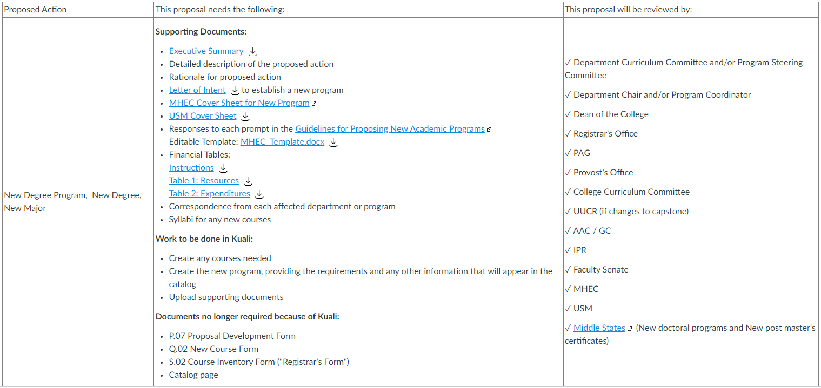

Slide 37
New Areas of Concentration

Slide 38
New Areas of Concentration
Areas of concentration are specializations that must be embedded with a degree program.
Area of concentration means a sequential arrangement of courses within a program that:
At the bachelor’s level is at least 24 semester credit hours;
At the master’s level is at least 12 semester credit hours above the bachelor’s degree;
At the doctoral level is at least 18 semester credit hours above the master’s degree.
Proposals for new areas of concentration within a degree program are considered substantial modifications by MHEC by must be accompanied by the MHEC Cover Sheet for New Program or Substantial Modification to Existing Program (Links to an external site.). All new areas of concentration proposals are required to address all of the prompts in the MHEC Guidelines for Proposing New Academic Degree Programs, New Stand-Alone Certificates, and Substantial Modifications (Links to an external site.). Proposals for new areas of concentration must be reviewed by PAG and IPR as part of internal review. USM approval is also required for new programs.

Slide 39
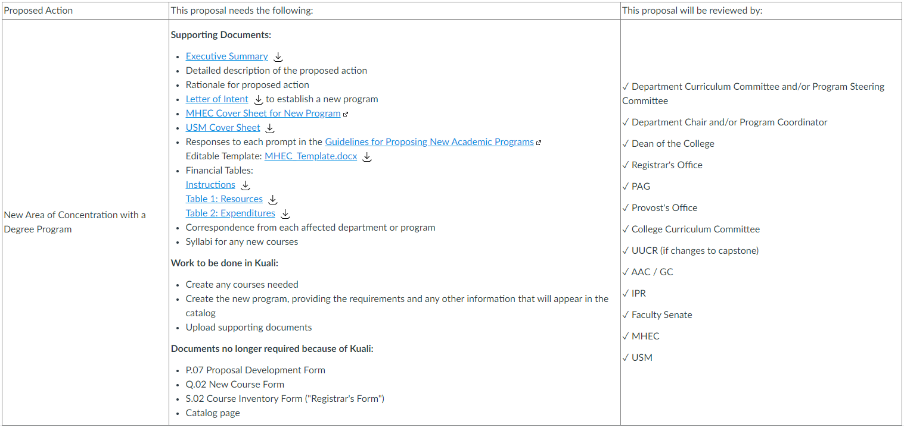

Slide 40
Change in Program Requirements

Slide 41
Change in Program Requirements
Degree Programs (Majors), Areas of Concentration, and Certificates
Changes to these programs require off-campus approval. FSU notifies USM of these changes. The complexity of the submission to MHEC is based on whether these changes are substantial or not. MHEC defines a substantial change as a change of 33 percent or more of the coursework in a program. This change is based on credit hours, and the gross change (not the net change) is used to determine whether the substantial modification threshold is crossed. Course deletions and additions count separately. Replacing a course with another course is two changes. For this reason, all proposals for changing program requirements require consultation with the Provost's Office to determine if a substantial modification proposal is needed.
For example, consider a program that requires 36 credits: 21 credits of Core Courses and a list of Electives from which students should choose 15 credits worth of courses.

Slide 42
Change in Program Requirements
The following changes are substantial:
Adding four 3-credit courses to the Core Courses, bringing the total number of credits to 48 credits. This is a 12-credit change: 12/36 = 0.33
Removing three 3-credit courses from the Core Courses and replacing them with one new 3-credit course. The overall number of credits in the program decreases by 6, but this is a 12-credit gross change: 9 credits of deletion and 3 credits of addition: 12/36 = 0.33
Replacing the 15 credits of electives with a choice of one of three tracks, each with 15 credits. While the number of credits in the program remains the same, this is a 30 credit gross change: 30/36 = 0.83
The following changes are non-substantial:
Moving a course from the Electives to the Core Courses, changing the requirements to 24 credits of Core Courses and 12 credits of Electives. This is a 6 credit change: 6/36 = 0.17
Adding a new 3-credit course to the list of approved electives. This is a 3-credit change: 3/36 = 0.08
Removing two 3-credit courses from the Core Courses, decreasing the total credits in the program to 30. This is a six credit change: 6/36 = 0.17

Slide 43
Change in Program Requirements
Substantial Modifications
Changes in program requirements that meet the definition of substantial modification must be accompanied by the MHEC Cover Sheet for New Program or Substantial Modification to Existing Program (Links to an external site.). There is a separate USM Cover Sheet for Substantial Modifications download. All substantial modifications are required to address all of the prompts in the MHEC Guidelines for Proposing New Academic Degree Programs, New Stand-Alone Certificates, and Substantial Modifications (Links to an external site.). Proposals for substantial modifications should be reviewed by PAG and IPR as part of internal review.
Please note: Programs can cross the substantial modification threshold through a series of non-substantial modifications. For this reason, all proposals for changing program requirements require consultation with the Provost's Office to determine if a substantial modification proposal is needed.
Please note: This proposal must not make any other changes to the program (e.g. modality, title, etc.). MHEC requires a separate proposal for each change.

Slide 44
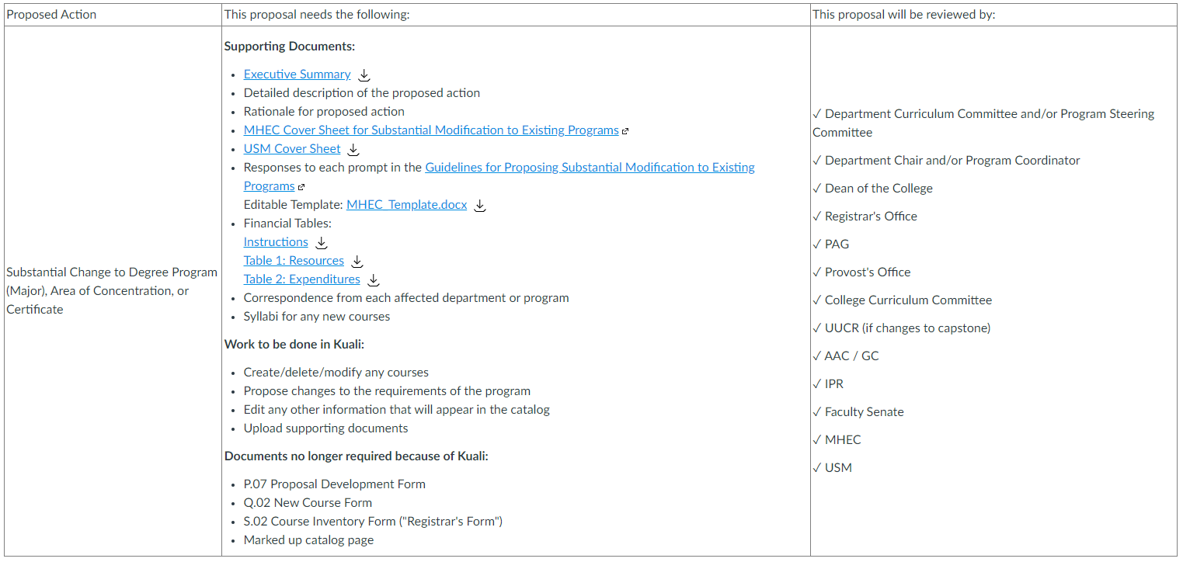
Substantial Modifications

Slide 45
Change in Program Requirements
Non-Substantial Modifications
Changes in program requirements that are not substantial must be accompanied by the MHEC Cover Sheet for Non-substantial Modification to Existing Program (Links to an external site.). The submission to MHEC is much simpler: FSU must submit a letter of notification that describes and provides a justification for the proposed change, along with supporting and/or comparative documentation (i.e. course outlines, course descriptions) from the existing and proposed programs. Proposals for non-substantial modifications do not require review by PAG and IPR as part of internal review
Please note: Programs can cross the substantial modification threshold through a series of non-substantial modifications. For this reason, all proposals for changing program requirements require consultation with the Provost's Office to determine if a substantial modification proposal is needed.
Please note: This proposal must not make any other changes to the program (e.g. modality, title, etc.). MHEC requires a separate proposal for each change.

Slide 46
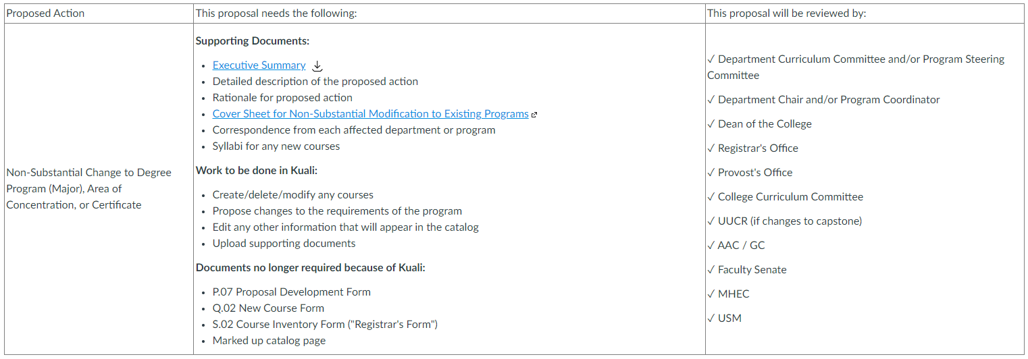
Non-Substantial Modifications

Slide 47
Change in Program Requirements
Minors, Options, Emphases, and Focuses
Neither MHEC nor USM reviews changes to these programs. No MHEC cover sheets or forms are needed.

Slide 48
Minors, Options, Emphases, and Focuses

