Slide 1
Kuali Workflow
August 30, 2021

Slide 2
Kuali Workflow Agenda
The Basics of Workflow
Groups
Course Workflow
Program Workflow
Subplan Workflow

Slide 3
Basic Workflow
Department/Program
College/ School
Governance
Proposer
Approved
Allows for Electronic Signatures
Variations Between Departments and Colleges
Email Sent to Designated Approvers from them the Review the Proposal

Slide 4
Proposers and Groups
Proposer could be program coordinator or department chair.
Proposals=any curriculum change. Unit of analysis moving forward is course, program, sub-plan.
Provost’s Office will manage permissions and groups.
https://frostburg-stg.kuali.co/cor/main/#/groups
Groups have already been established; “chairs” will be designated as well as authorized approver for the group as each person will be able to view proposals.

Slide 5
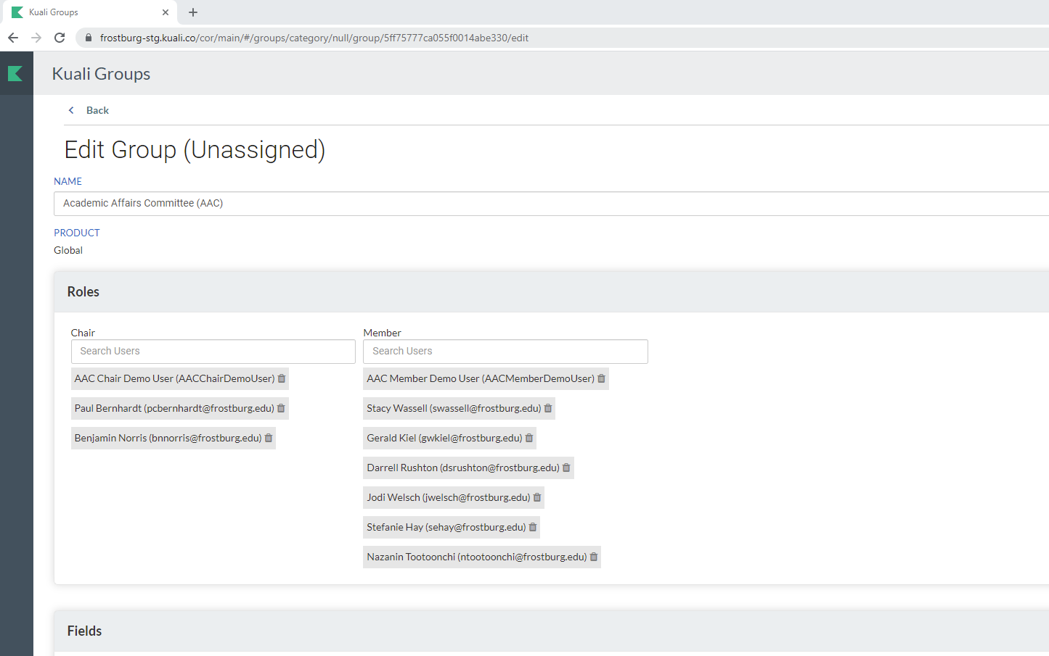

Slide 6
Course Workflow https://frostburg-stg.kuali.co/cm/#/flowbot/5f75d4a53e35ee001be105e7

Slide 7
Program Workflow https://frostburg-stg.kuali.co/cm/#/flowbot/5f75d4a53e35ee001be105e7

Slide 8
Sub-Plan Workflow https://frostburg-stg.kuali.co/cm/#/flowbot/60416bf3a340b8001b0e450b

Slide 9
Reviewing Proposals
The workflow lists the designed people who will need to review proposals.
Multiple Ways to Review:
Email from Kuali with Review Prompt
Link to Proposal Sent from Other Users
Action List
Proposal Section on the Left Navigation
Agenda Builder

Slide 10
Reviewing Proposals
Three Review Options
Approve (Or Re-Approve)
If you approve the proposal, select Approve (or Re-Approve).
Send Back
If the proposals needs changes, select Send Back. Add comments to explain why you are sending the proposal back. Select whether the proposal will come back to you or through the workflow. Use the “Prev/Next” to determine the person who will make the changes.
Reject
Rejecting a proposal does not allow for any revisions. A new proposal will need to be created from scratch after rejection.

Slide 11
Action List
The Action List is a list of items that are waiting for your approval.
It can be found in the upper-right corner.

Slide 12
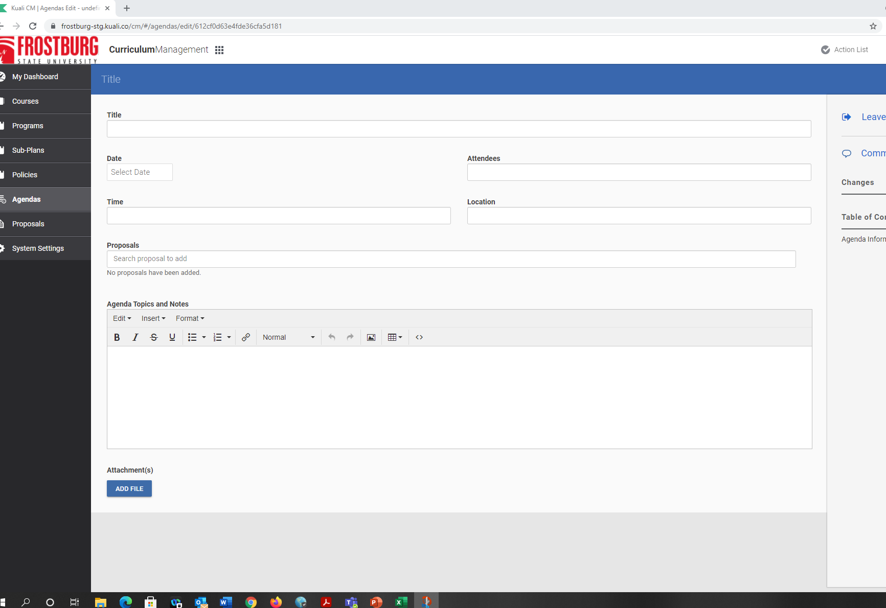
Next steps: Agenda Building https://curriculum.utah.edu/kualicm/training.php#agenda
[Information]

